Slide 1
Robot Motion

Slide 2
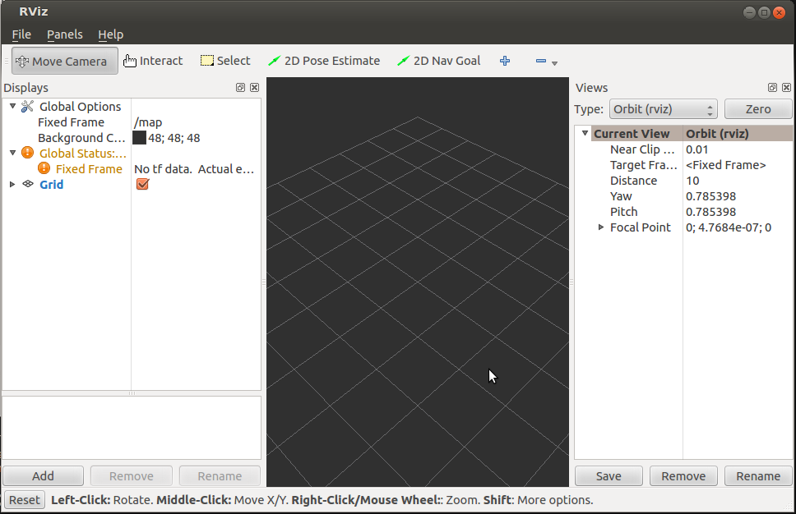
rviz
ROS Visualization tool

Slide 3
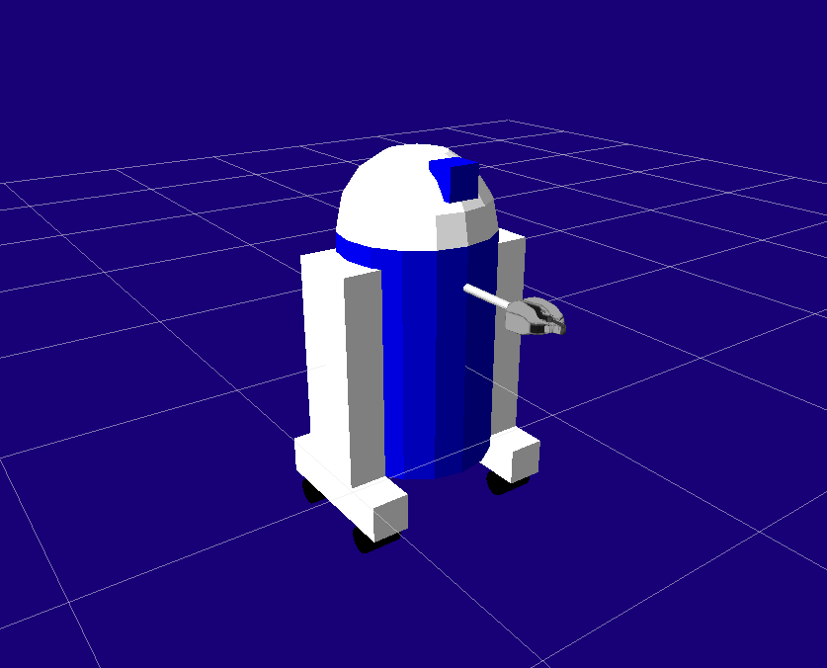
URDF: Unified Robot Description Format
URDF files specify a robot’s visual model, boundaries, physical properties, and tf frames
Used in visualization, simulation, and interaction of robots
Can include complex meshes created in 3D graphics editors for custom objects

Slide 4
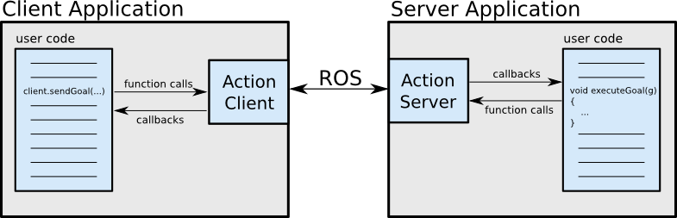
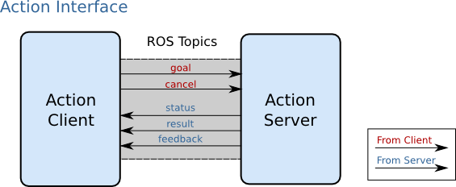
Actionlib
The actionlib package provides tools for initiating long-running tasks, getting feedback, cancelling, and
It uses actions to define the goal, feedback, and final output of a task
Ex. Request a robot moves to a point (goal), along the way send its current position (feedback), when it arrives it send a picture from the camera (result)
http://wiki.ros.org/actionlib

Slide 5
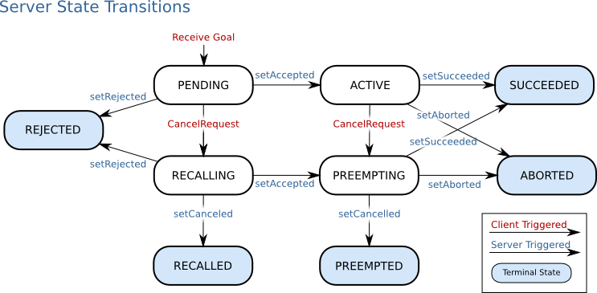
Actionlib: Server

Slide 6
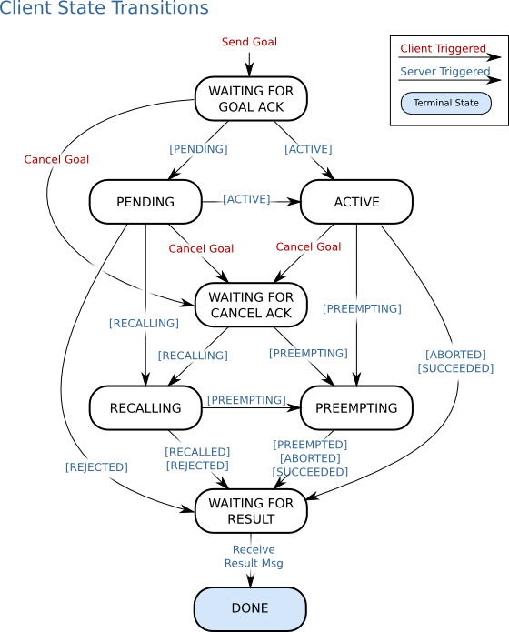
Actionlib: Client
1 #! /usr/bin/env python
2
3 import roslib
4 roslib.load_manifest('my_pkg_name')
5 import rospy
6 import actionlib
7
8 from chores.msg import DoDishesAction, DoDishesGoal
9
10 if __name__ == '__main__':
11 rospy.init_node('do_dishes_client')
12 client = actionlib.SimpleActionClient('do_dishes', DoDishesAction)
13 client.wait_for_server()
14
15 goal = DoDishesGoal()
16 # Fill in the goal here
17 client.send_goal(goal)
18 client.wait_for_result(rospy.Duration.from_sec(5.0))

Slide 7
Today

Slide 8
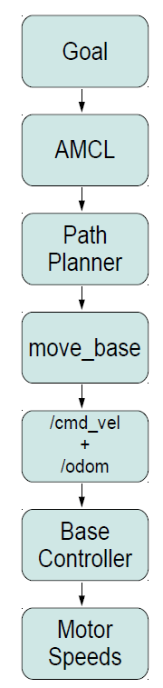
Motion Control
There is a hierarchy of motion controllers in ROS ranging from high-level semantic control to path planning to simple base controllers
The base controller node subscribes to the /cmd_vel topic and translates Twist messages into motor signals that actually turn the wheels.

Slide 9
Motion Control

Slide 10
Motion Messages and Topics
geometry_msgs/Twist:
geometry_msgs/Vector3 linear
float64 x
float64 y
float64 z
geometry_msgs/Vector3 angular
float64 x
float64 y
float64 z
Topics:
/cmd_vel
/cmd_vel_mux
/cmd_vel_mux/input/teleop

Slide 11
Lab Activity 6
Grab a computer, use your own, or partner up!
If you are using your own laptop and haven’t installed Ubuntu or ROS please do so. See the installation guide on the course wiki page or the instructors for help
Open Terminal
Navigate to ROS-Spring2019
git pull
Open the week6 directory and complete the exercises in lab6.txt
WIFI: Westgate-STEM PASSWORD: TheDesignProcess

